Slide 1
Biologically-based Error Driven Learning for Deep, Bidirectional Vision
Randall C. O’Reilly
University of Colorado Boulder
eCortex, Inc

Slide 2
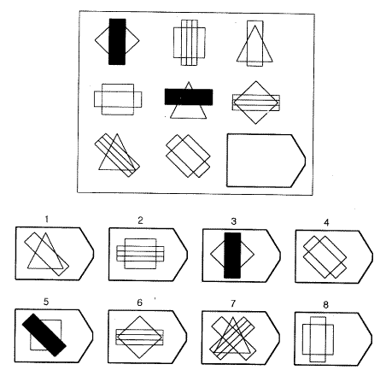
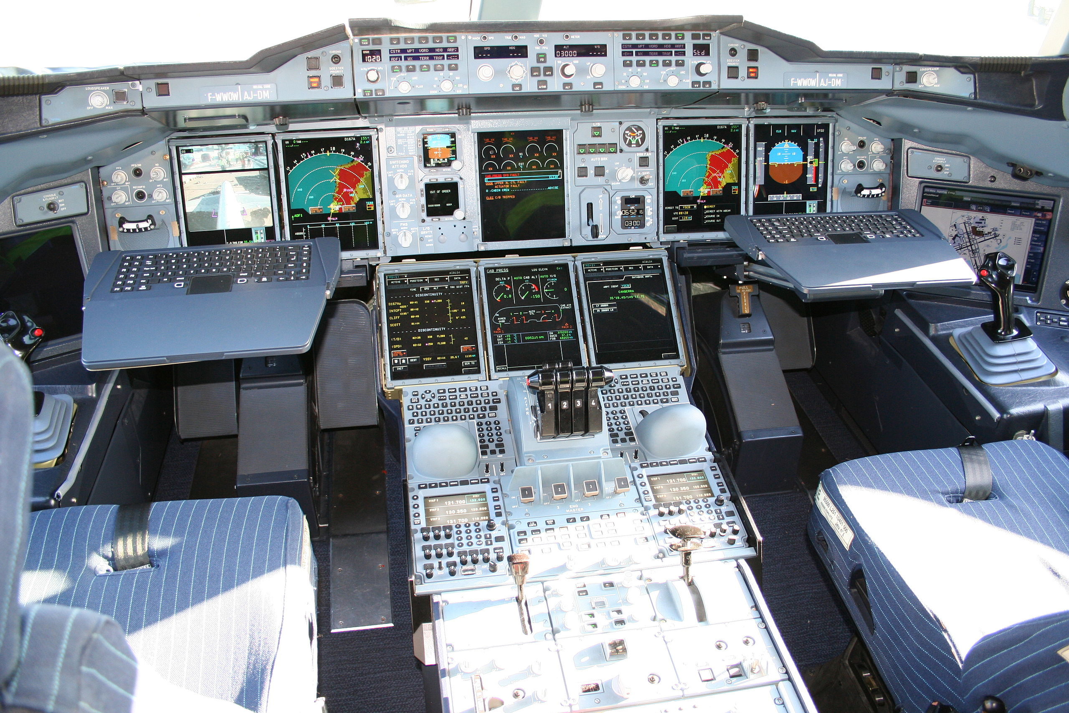
Cognitively: What is Vision For?
Vision is active, goal-driven, requires iterative, flexible parsing of complex visual scenes

Slide 3
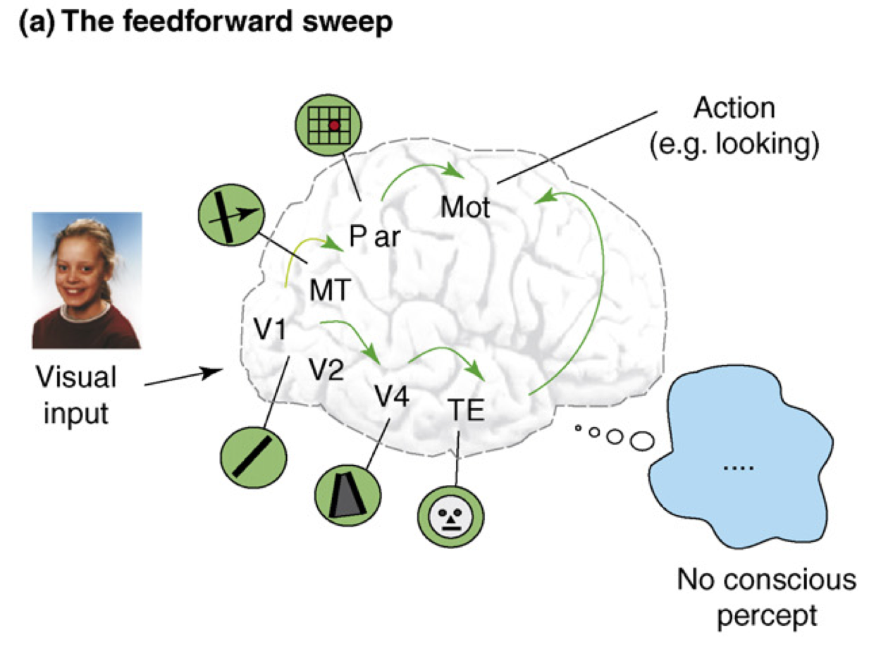
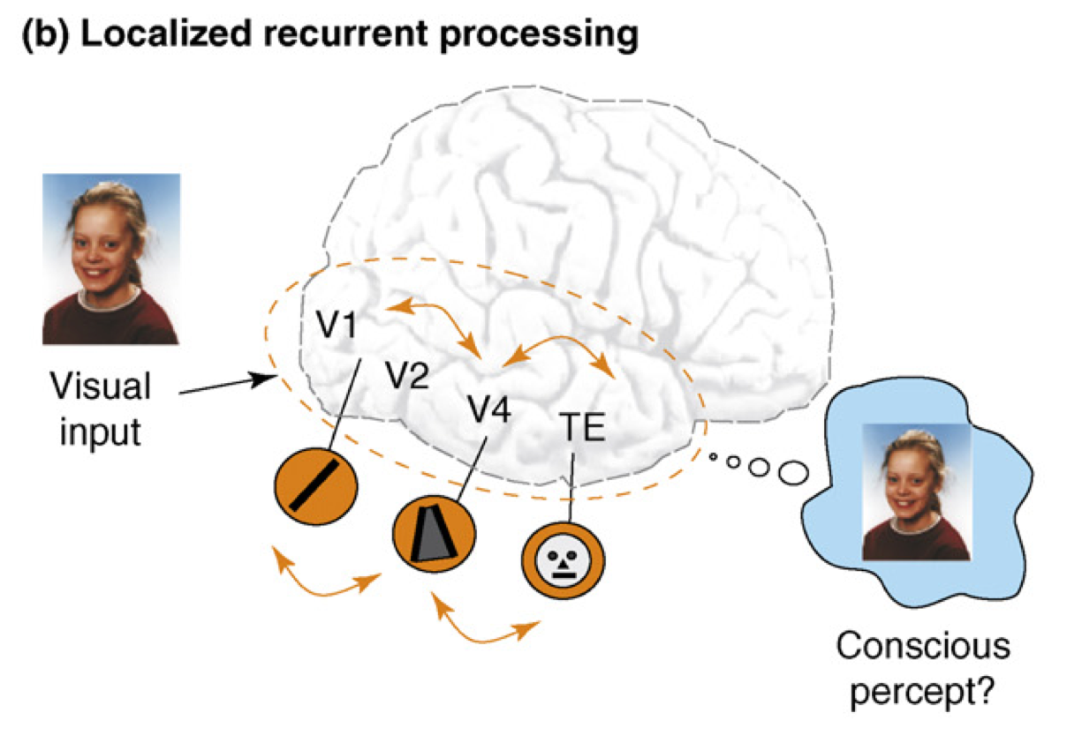
Recurrent Processing -> Consciousness (Lamme, 2006)
Consciousness is Unitary
Recurrence coordinates all areas on one thing (emerges via popular vote)
Consciousness is Functional
Helps organize, prioritize behavior – “focusing” key for difficult problems
Consciousness Flows
Temporal dynamics and information processing (multi-step cognition)

Slide 4
Outline
Recurrent dynamics / consciousness supports goal-driven top-down interaction with bottom-up visual processing: How to capture in a model?
Bonus: Biological error-driven learning can use recurrent connectivity to communicate gradients
Superficial cortical layers = basic Hopfield / Boltzmann style recurrent network
Deep cortical layers & thalamus = specialized attentional network, key for robust, flexible attn

Slide 5
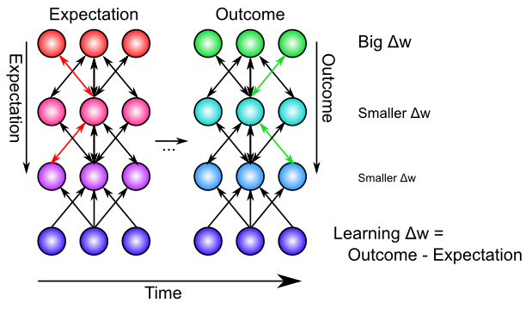
Bidirectional Connections Carry Error Gradients (GeneRec; O’Reilly, 1996)
Generalization of Recirculation (Hinton & McClelland, 1988)

Slide 6
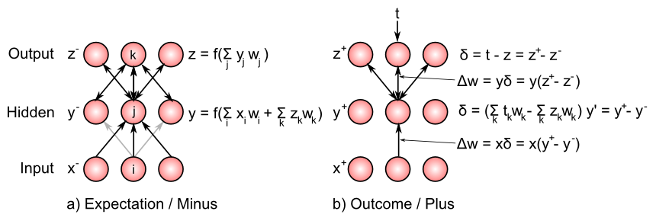
Bidirectional Connections Carry Error Gradients (GeneRec; O’Reilly, 1996)
Midpoint integration + symmetry = Contrastive Hebbian = DBM

Slide 7
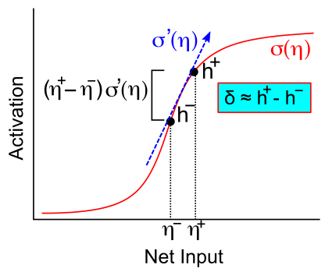
Activation Diffs Implicitly Compute Derivatives (GeneRec; O’Reilly, 1996)
Free to use arbitrarily complex activation functions!

Slide 8
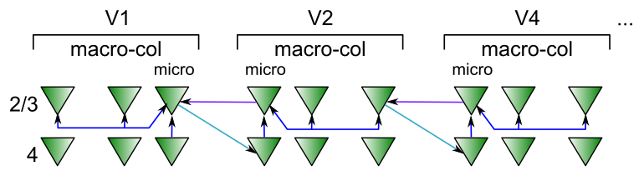
Superficial Attractor / Constraint Satisfaction Network
Computationally captured by Hopfield / (Deterministic) Boltzmann Machine models..
Except that cortical pyramidal neurons are only excitatory – need inhibitory interneurons

Slide 9
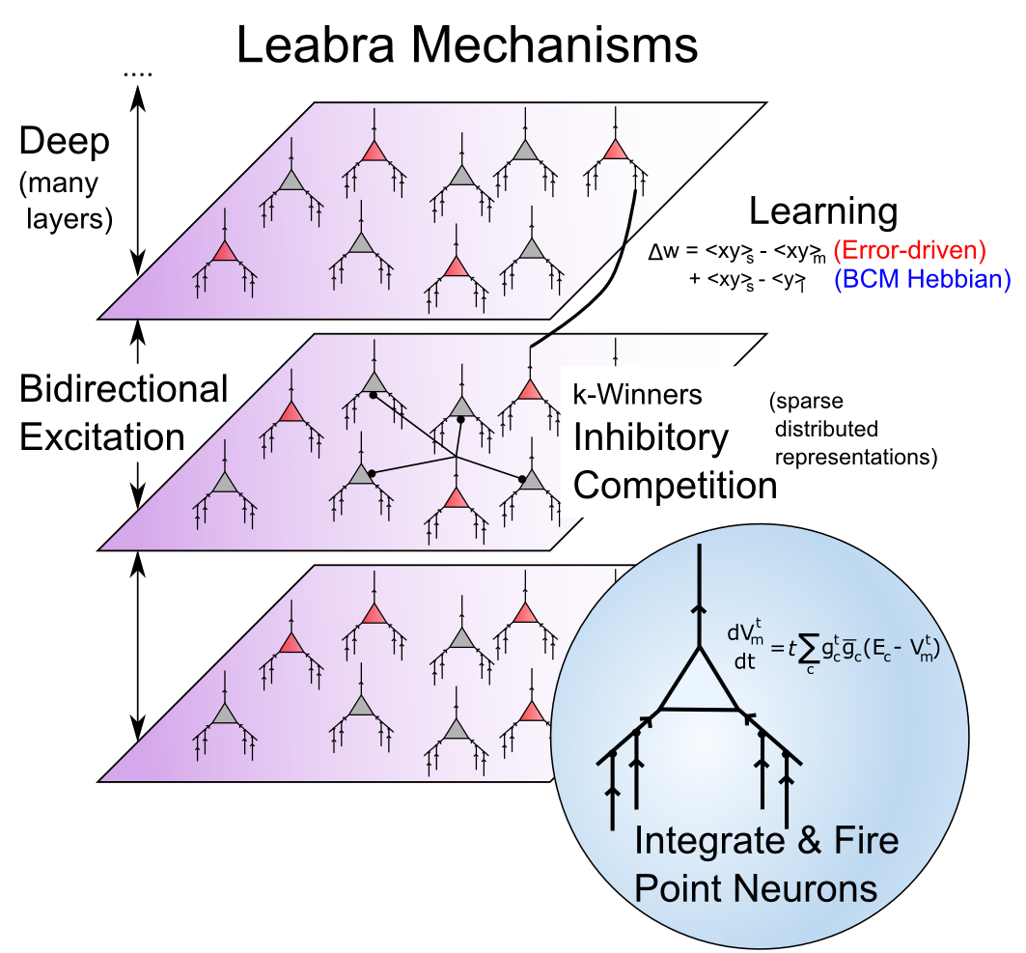
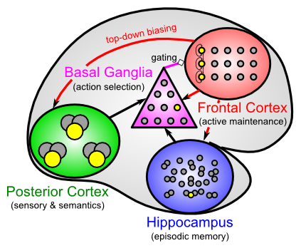
Leabra Biologically-based Cognitive Architecture
LSTM
Same framework accounts for wide range of cognitive neuroscience phenomena: perception, attention, motor control and action selection, learning & memory, language, executive function – all built out of the same neurons.
http://ccnbook.colorado.edu

Slide 10
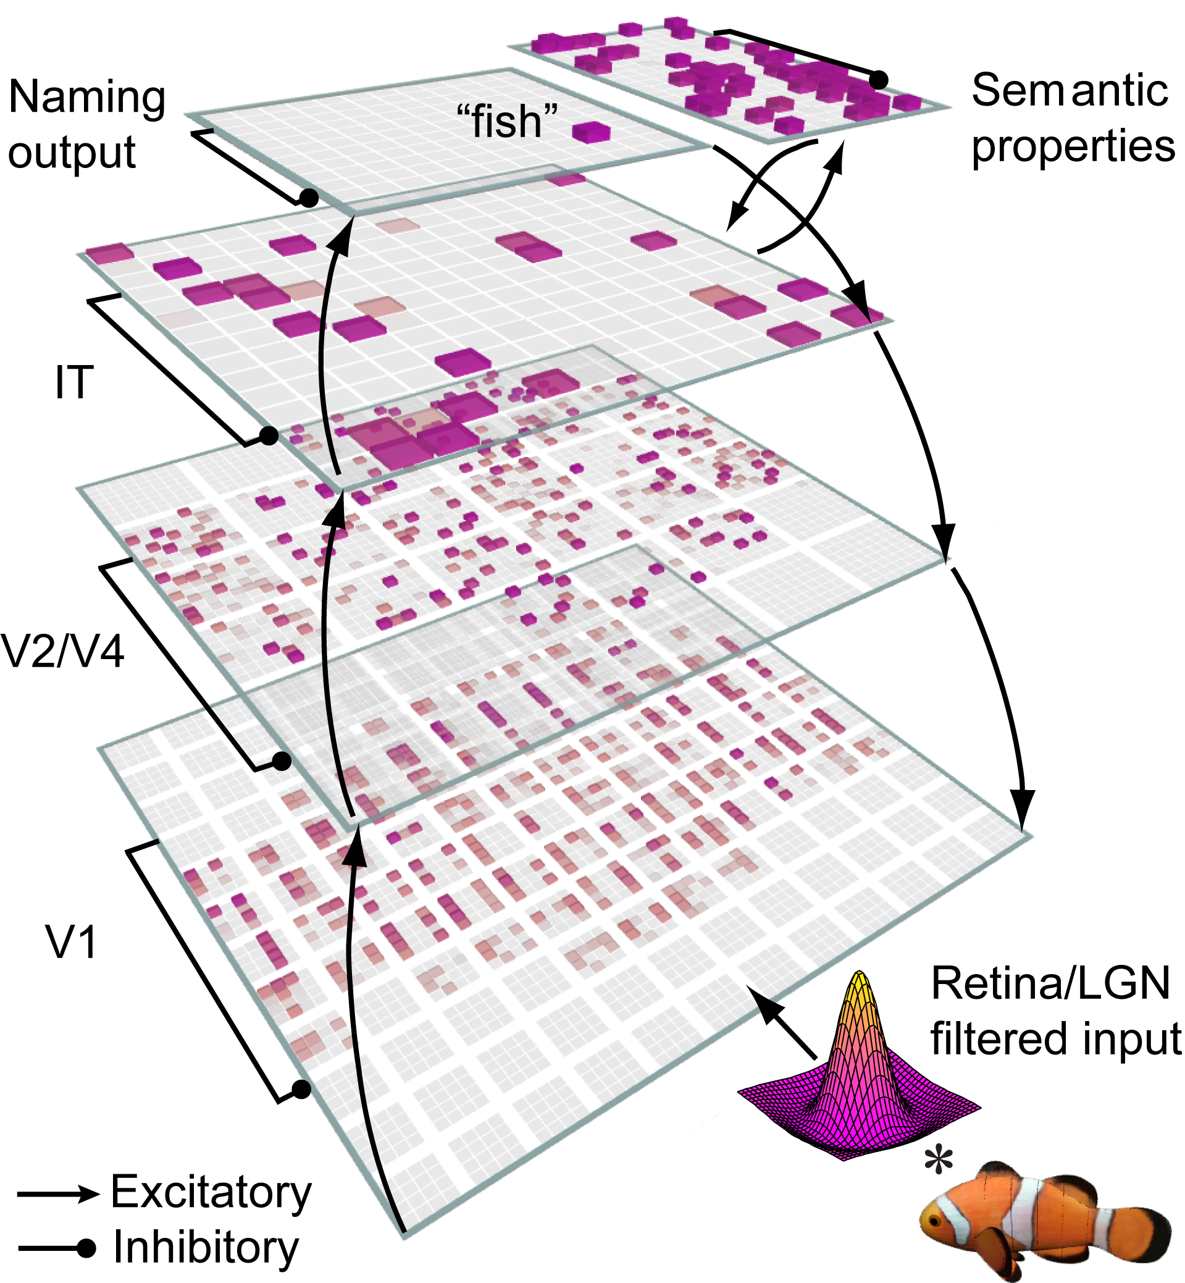
Bidirectional Object Recognition (e.g., O’Reilly et al., 2013)
100-way invariant object recognition

Slide 11
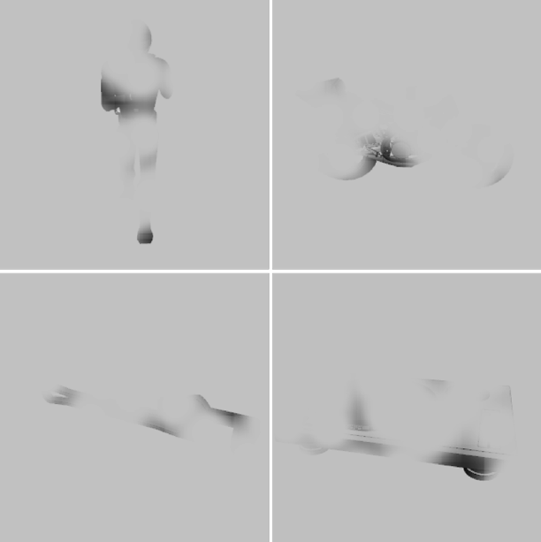
Benefit of Bidirectionality: Robust to Partial Occlusion

Slide 12
Human Data (Wyatte et al, 2012)

Slide 13
The Good News…
Backpropagation is biologically plausible (according to me at least! :)
Current deep backprop nets can plausibly claim to be capturing something about actual brain
Recent mods e.g., ReLU, sparse coding are also biologically consistent
Bidirectional / recurrent dynamics have functional benefits, and fit human data..

Slide 14
The Bad News…
Attractor nets don’t pull out individual elements from complex scenes, or rapidly shift (instead, get “stuck”)

Slide 15
DeepLeabra Solution
Top-down / bottom-up attentional dynamics: deep layers particularly important for top-down.
Predictive learning based on t-1 context representations (SRN), also in deep layers.
Thalamic relay cells (TRC) are substrate for local auto-encoder learning.

Slide 16
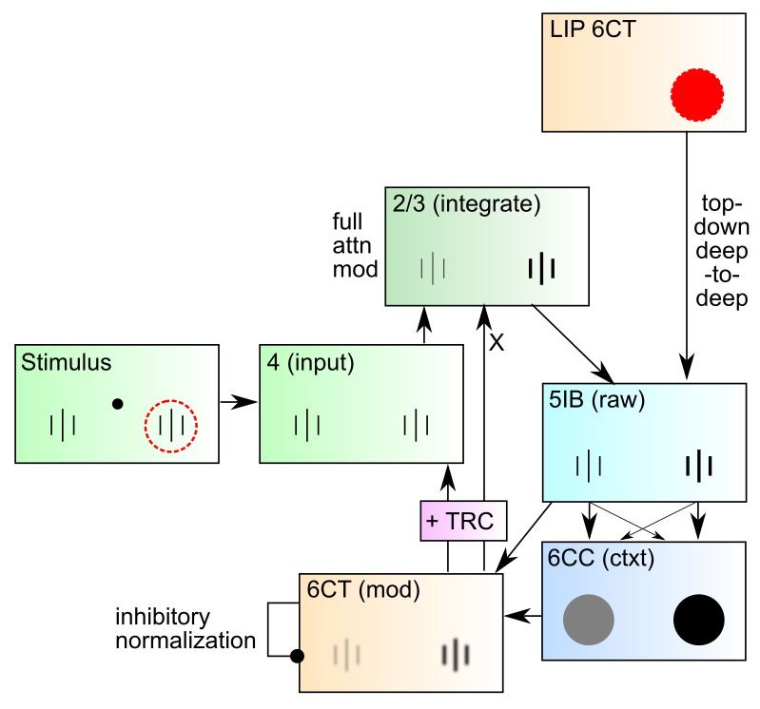
DeepLeabra Attentional Dynamics

Slide 17
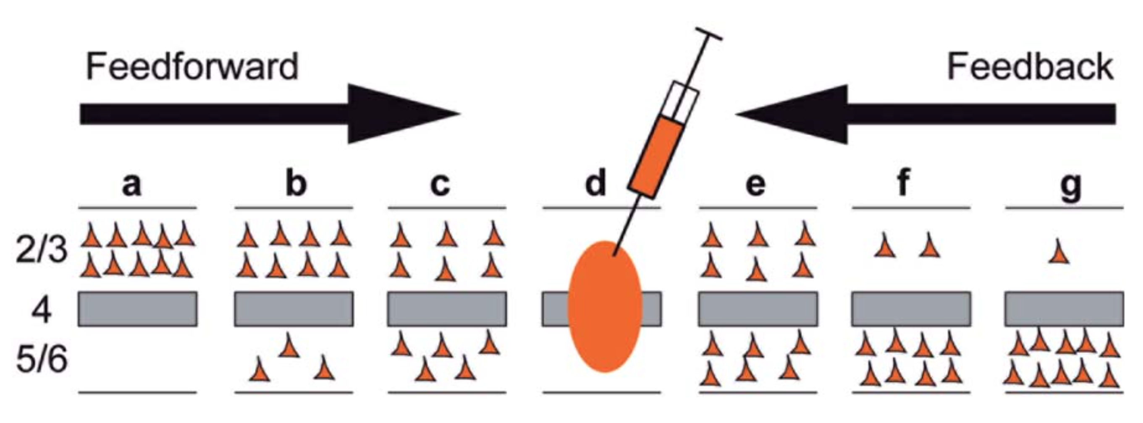
Deep Dominates Feedback
Markov et al, 2014
Feedback projections, especially those further up the hierarchy, are predominantly from deep layers – deep is particularly important for top-down attentional processing..

Slide 18
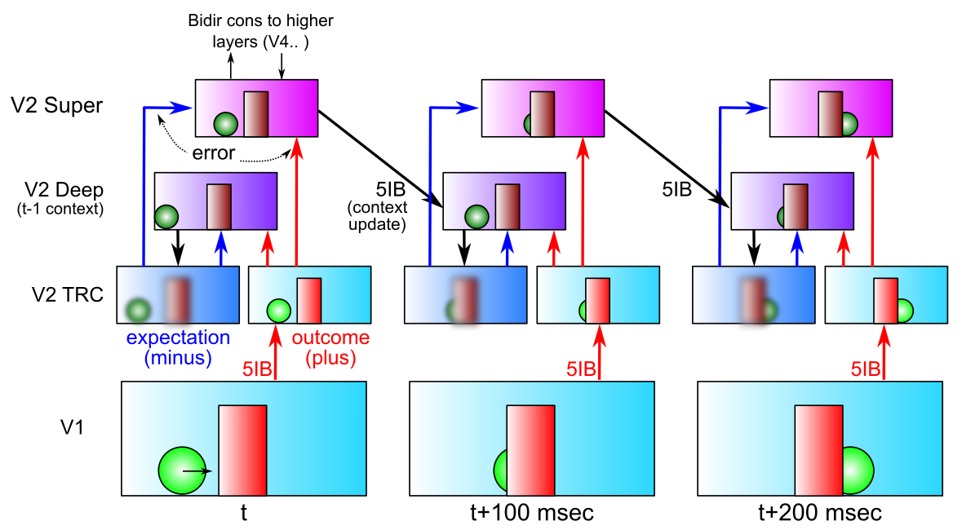
DeepLeabra Predictive Learning
Predictive learning creates nearly infinite supply of challenging learning problems: can learn a lot about physics and visual structure
Widely exploited idea: Helmholtz, Elman, Hawkins…
Requires encoding of prior context for future prediction (SRN)

Slide 19
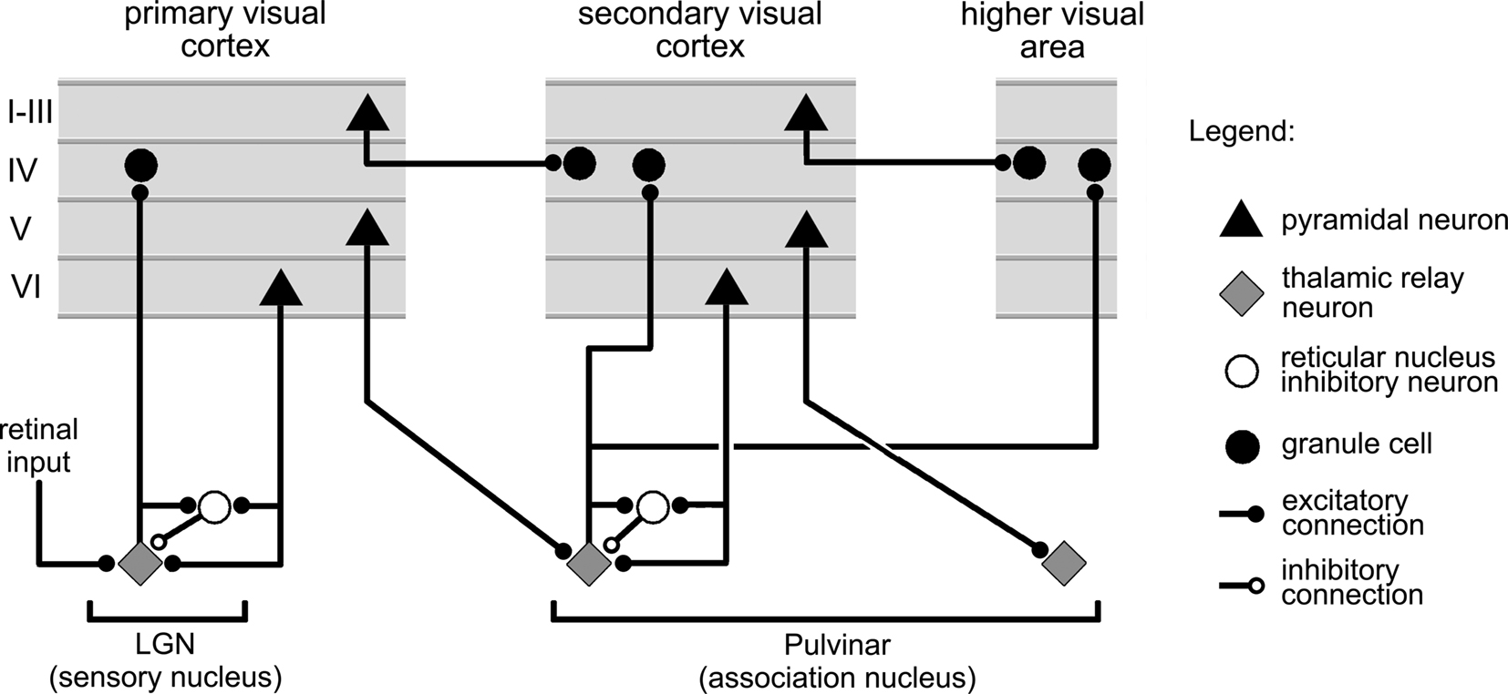
More Brain to the Rescue? (Sherman & Guillery, 2006)
Deep Layers drive thalamus, have strong top-down feedback effects
Pulvinar strongly implicated in visual attention..

Slide 20
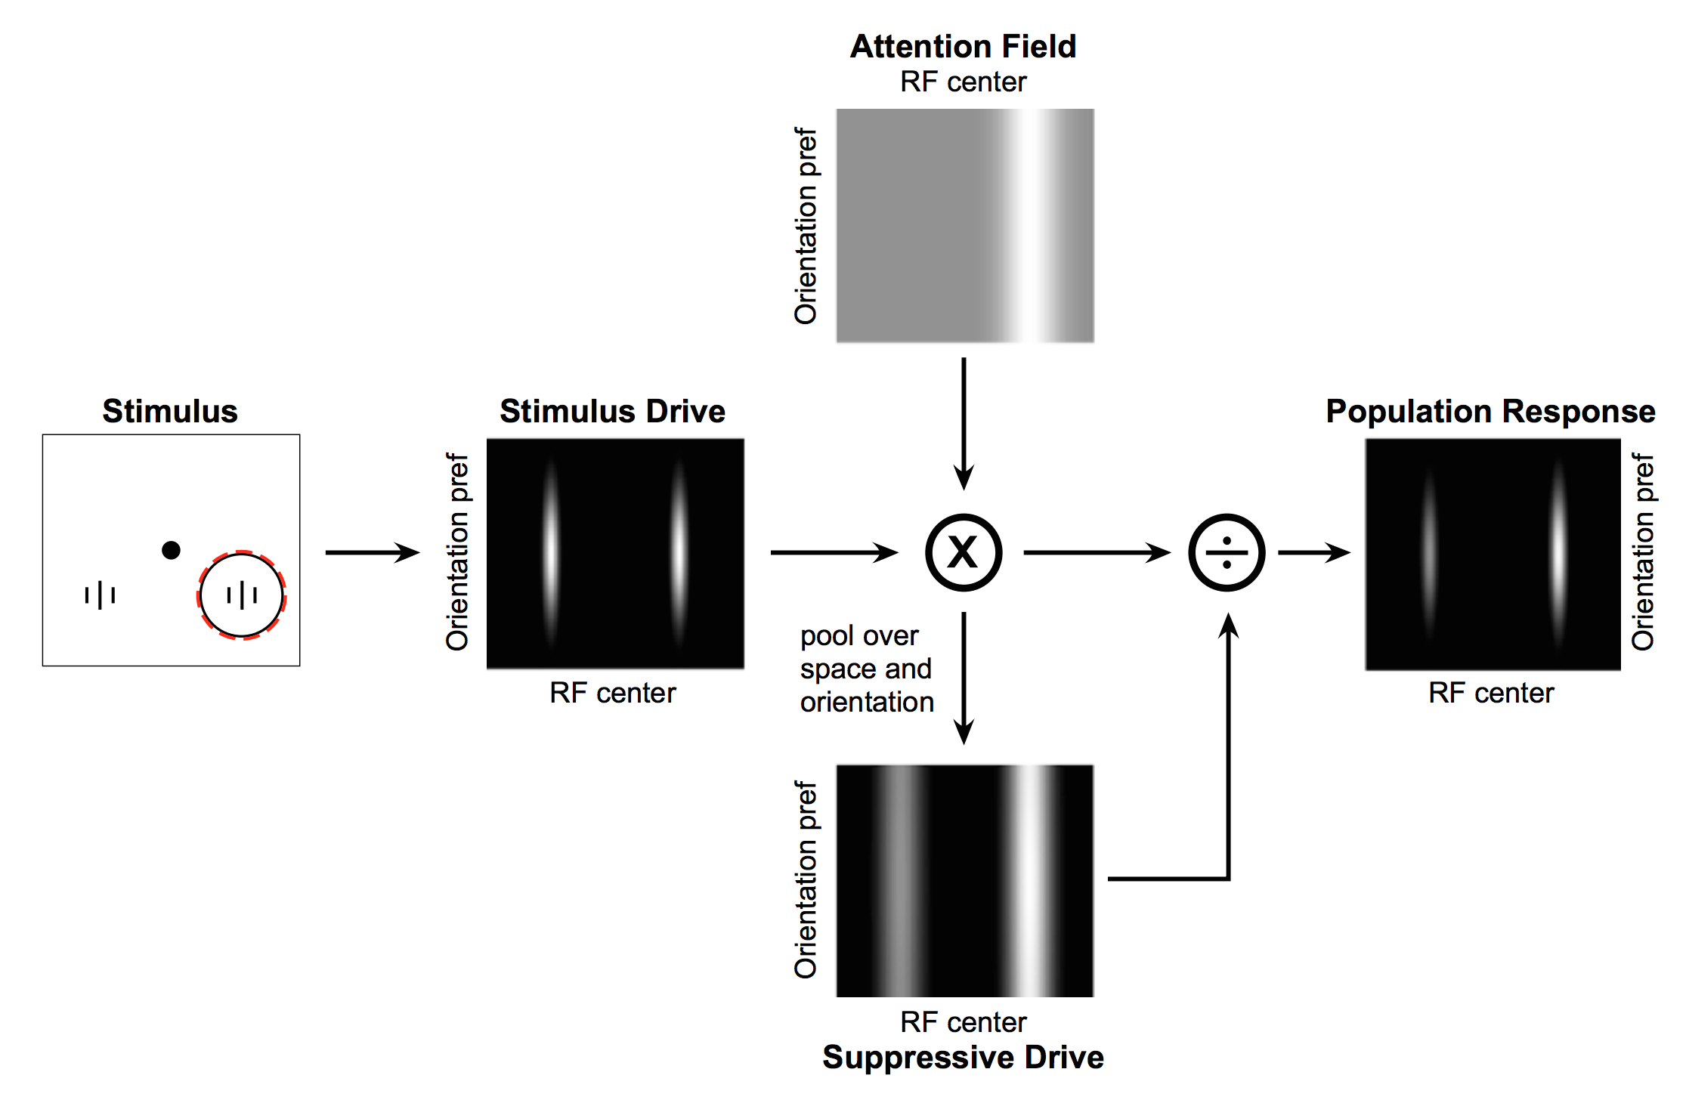
Deep Attentional Dynamics (Reynolds & Heeger, 2009; Grossberg, 1999)
Top-down deep layer
Attentional drive
Inputs to Layer 4
Layer 6 gain control
(Olsen, Bortone et al)

Slide 21
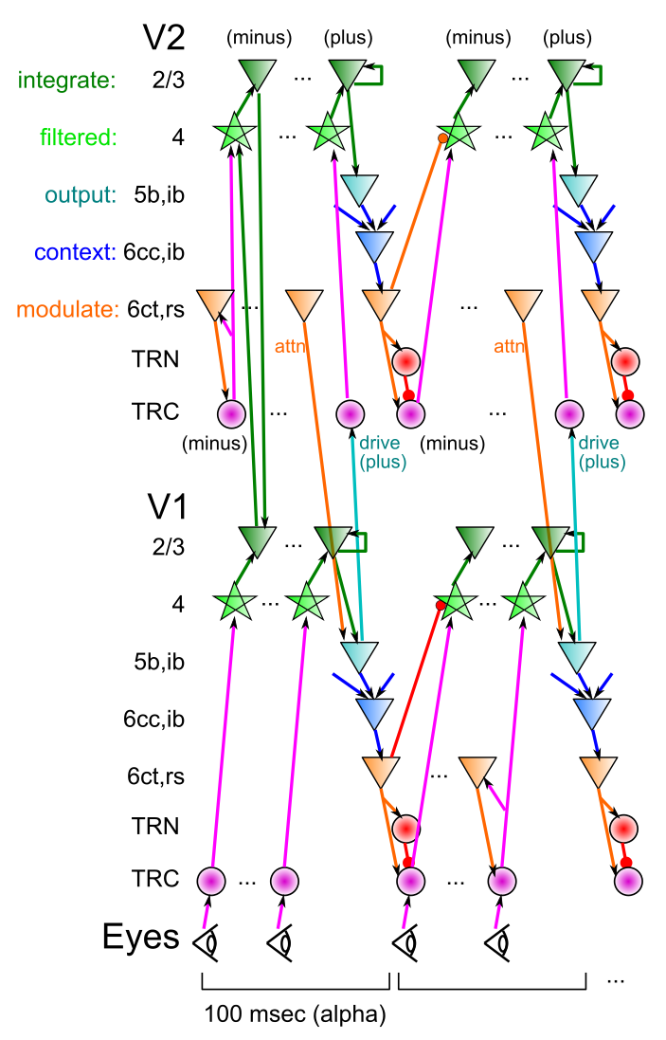
DeepLeabra
Deep neocortical layers drive multiplicative attentional modulation, through direct and thalamically mediated connections.
Alpha cycle (100msec) provides frame rate for updating of attentional mask, determined by 5ib bursting
EM-like dynamics where superficial network settles within fixed attentional mask, then attn mask is updated..
5ib also drives feedforward TRC prjn: plus phase clamp of TRC-based autoencoder (local learning signals)
6cc context provides SRN-like temporal context information for predictive learning

Slide 22
Thalamocortical Mysteries
Why does higher-order thalamus have a few strong driver inputs, and far more weaker ones?
Why are these drivers non-plastic? How can cortex learn if thalamus does not?
TRC as auto-encoder: FF drivers provide “plus phase” training signal, as fixed xform of input layer
What is function of the alpha rhythm (10Hz), which predominates in deep layers and thalamus?
EM outer loop, defines minus-plus learning frame

Slide 23
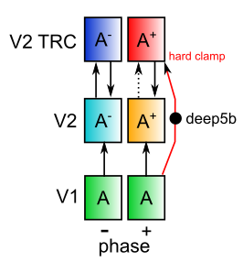
Nested Thalamic Auto-Encoders (Deep5aed: Deep5b Auto Error Driven)
Really is a standard auto-encoder!

Slide 24
Current Results
Deep attentional dynamics can pick out figure object against background – motion and binocular depth cues provide figure signal.
TRC auto-encoder on V2, V3 produces some learning benefits.

Slide 25
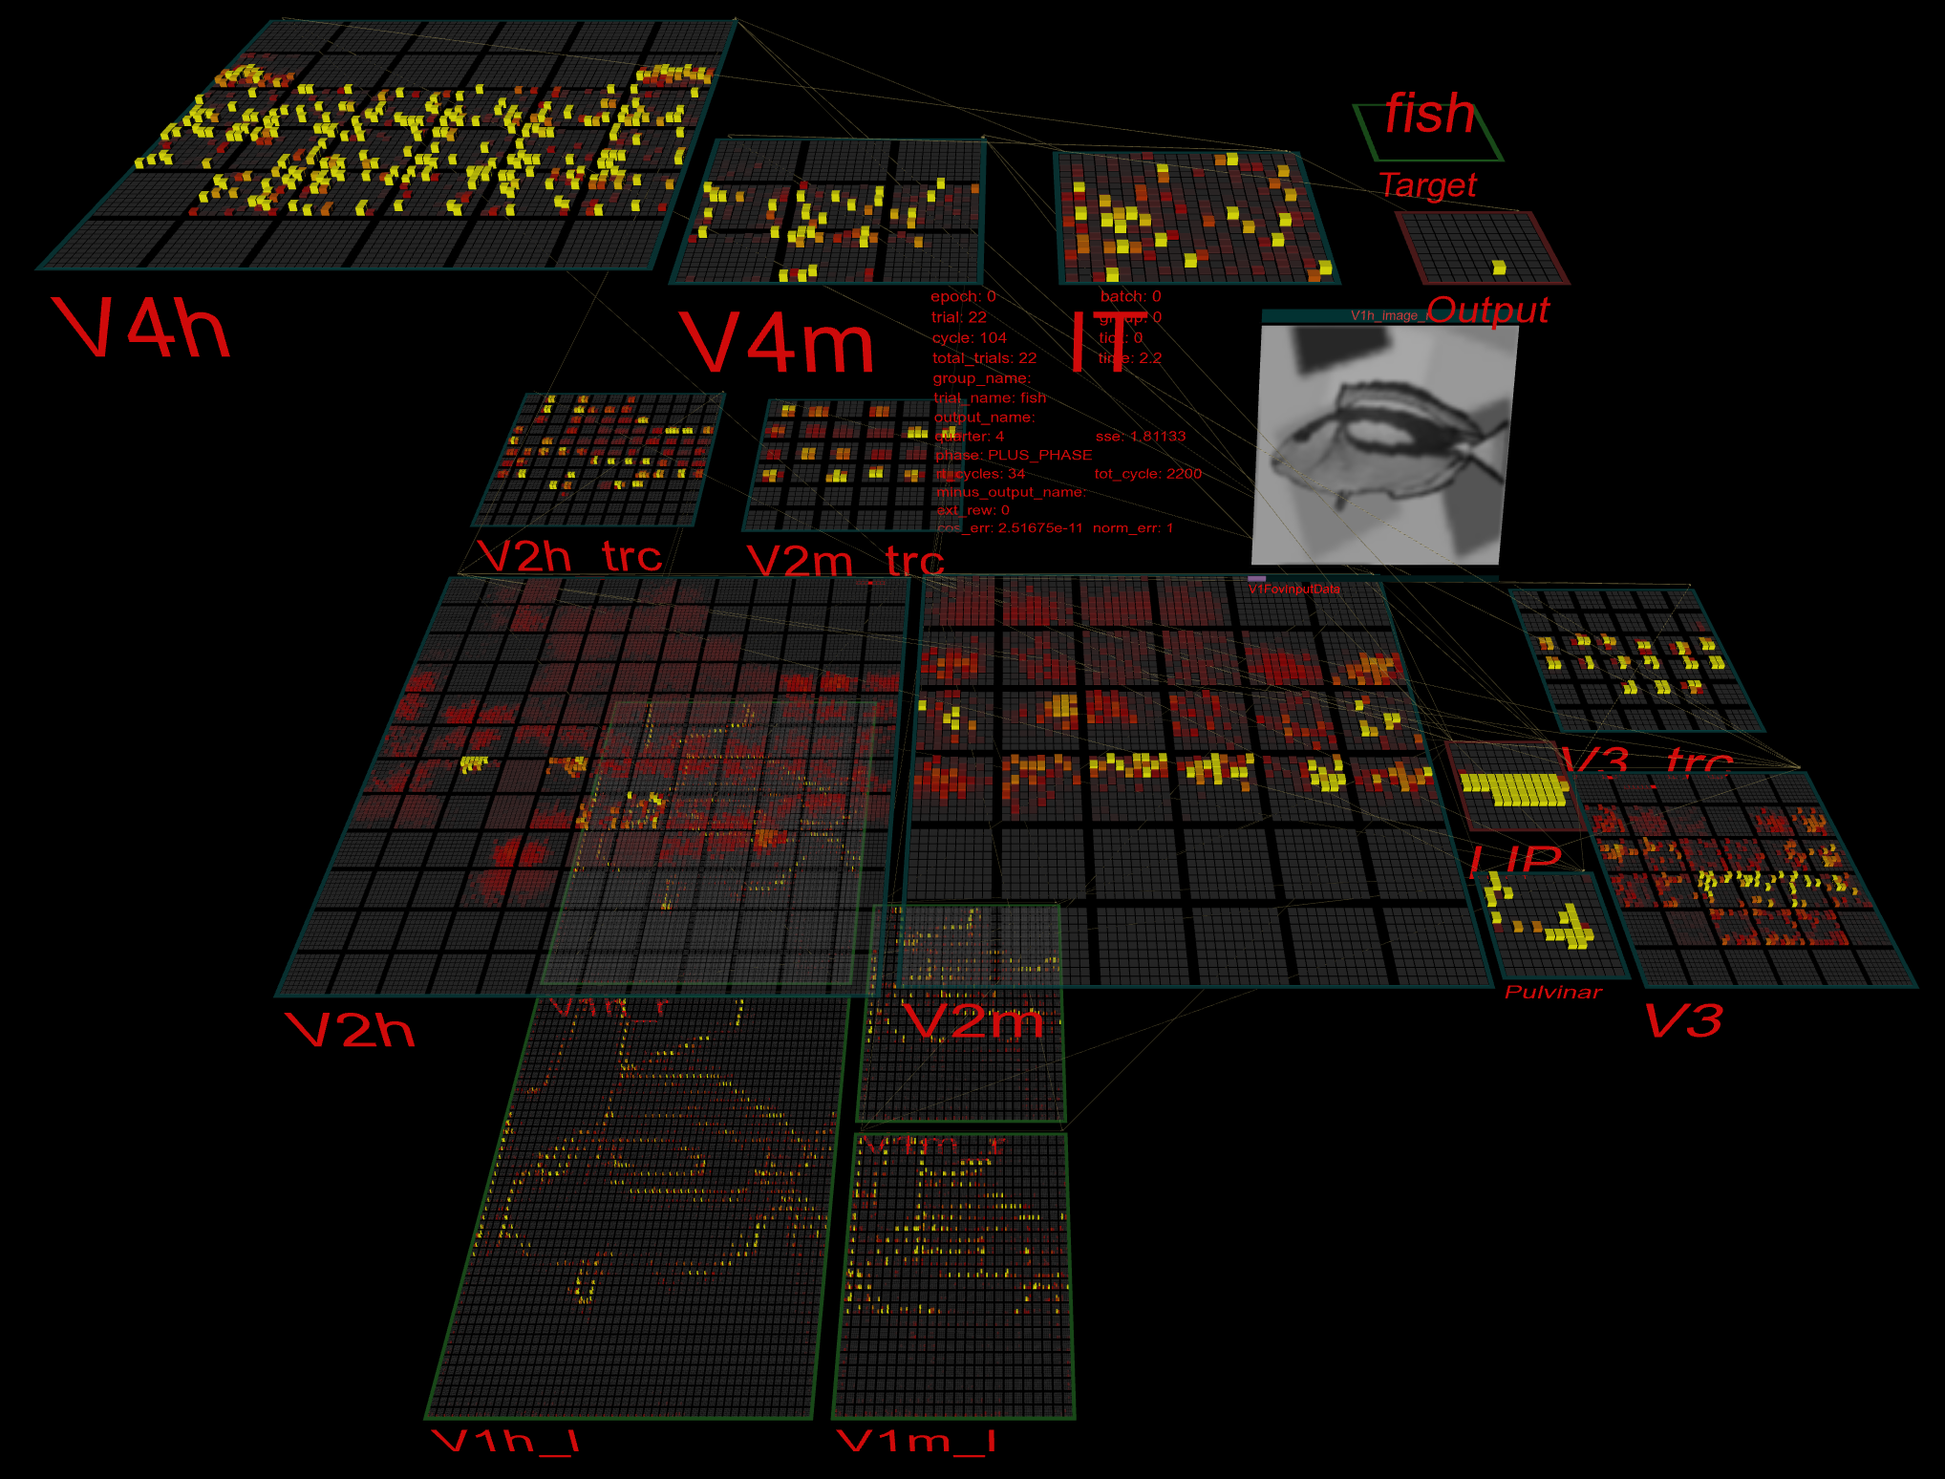
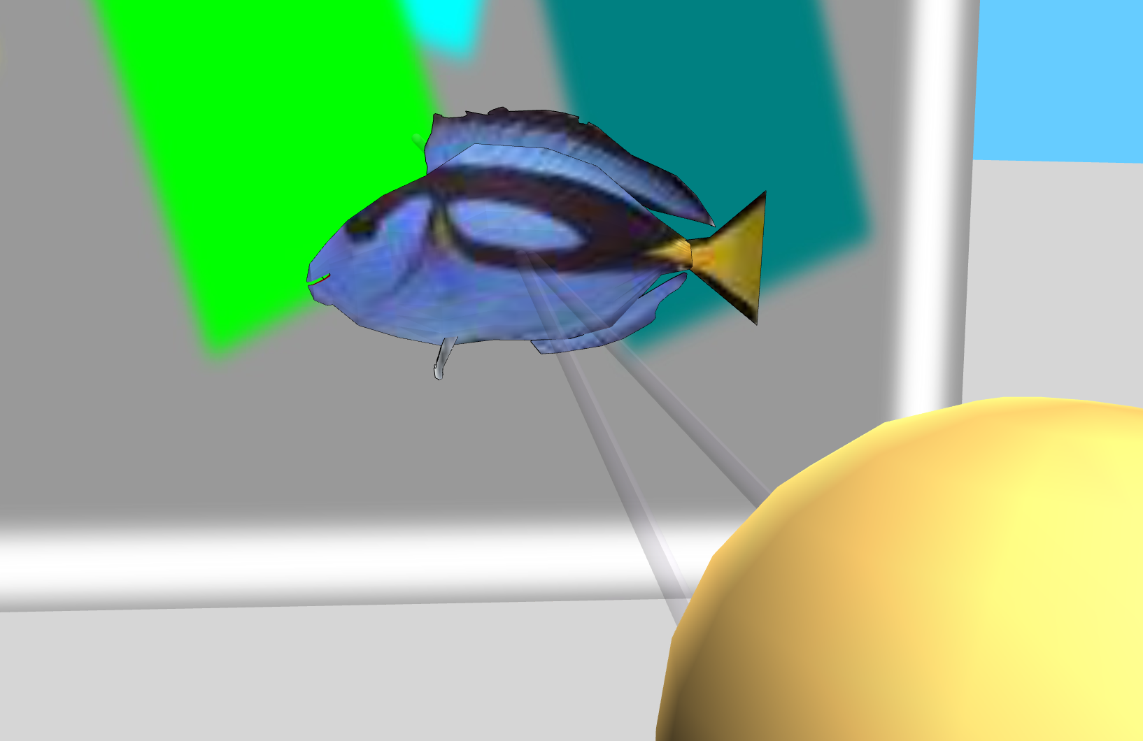
3D Virtual Reality Learning

Slide 26
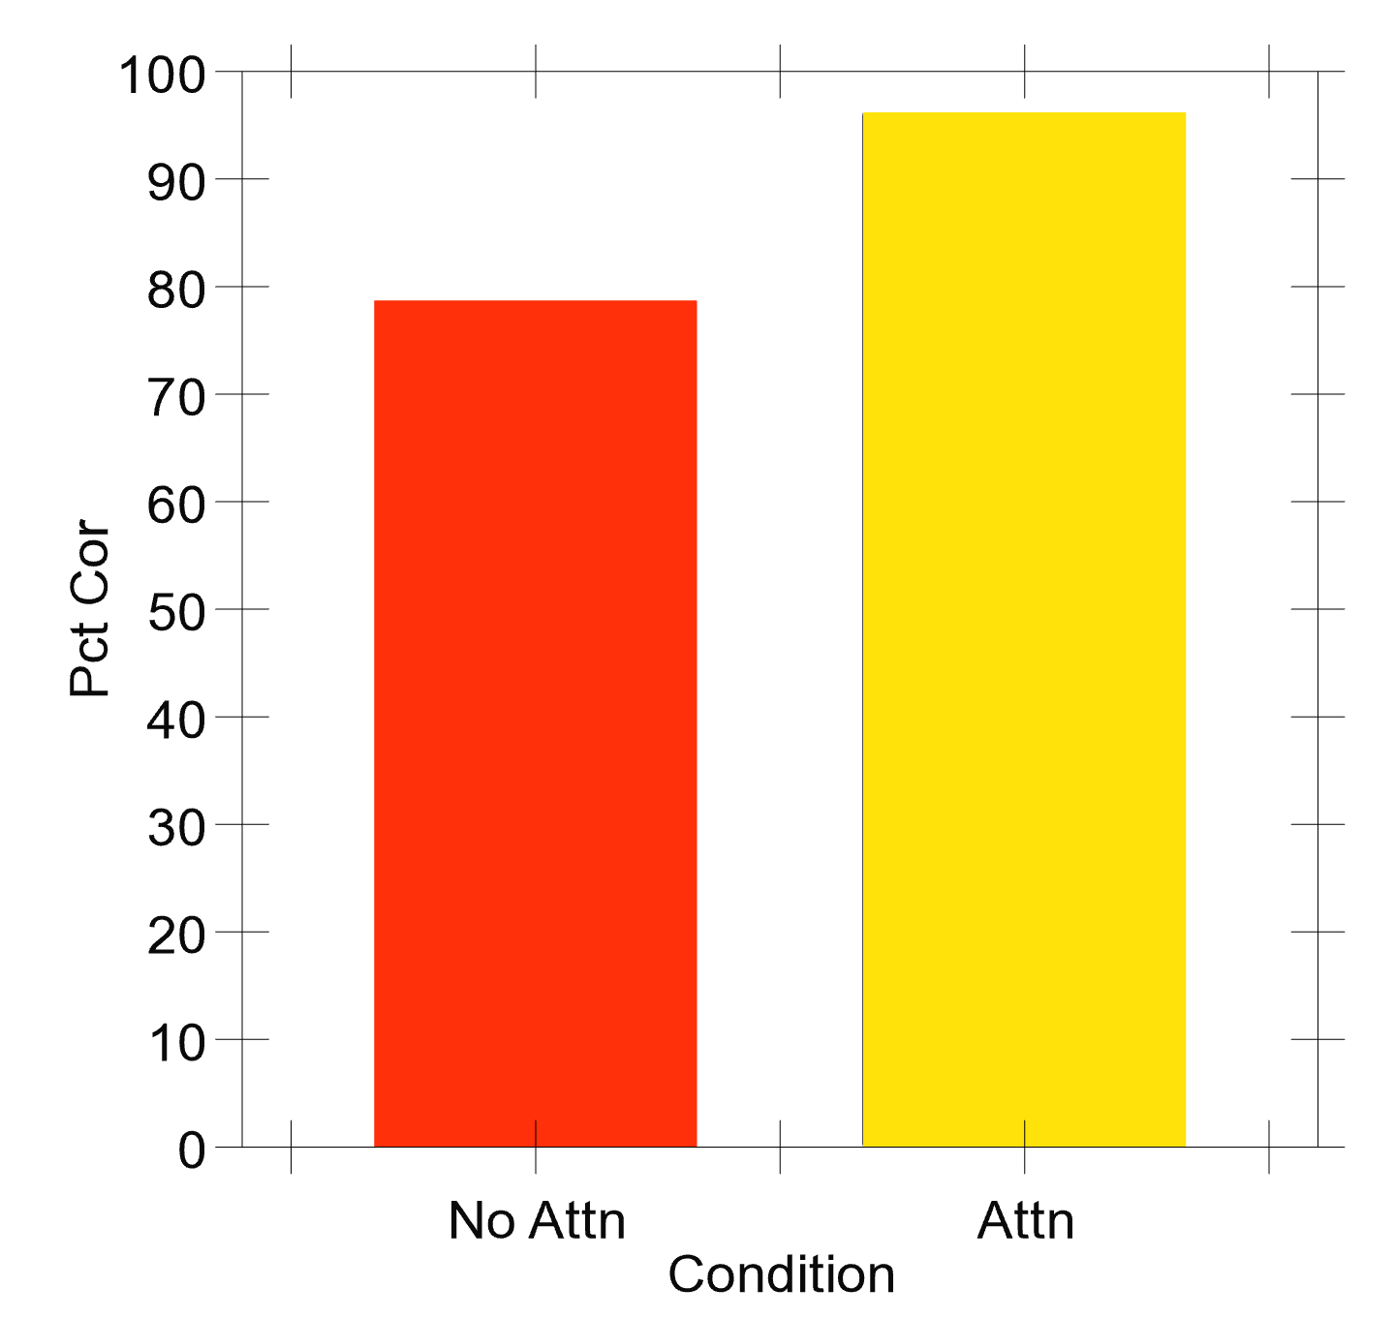
Very Preliminary Results..
50 objects against complex backgrounds..

Slide 27
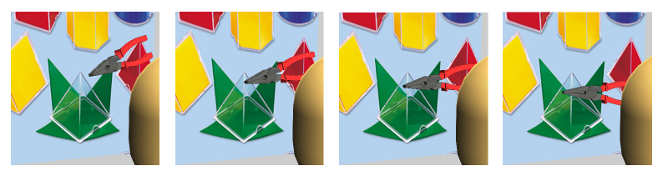
Auto-Encoder over Time: Predictive Learning
Predictive learning creates nearly infinite supply of challenging learning problems: can learn a lot about physics and visual structure
Widely exploited idea: Helmholtz, Elman, Hawkins…
Requires encoding of prior context for future prediction
LeabraTI: temporal integration – also uses deep5b bursting

Slide 28
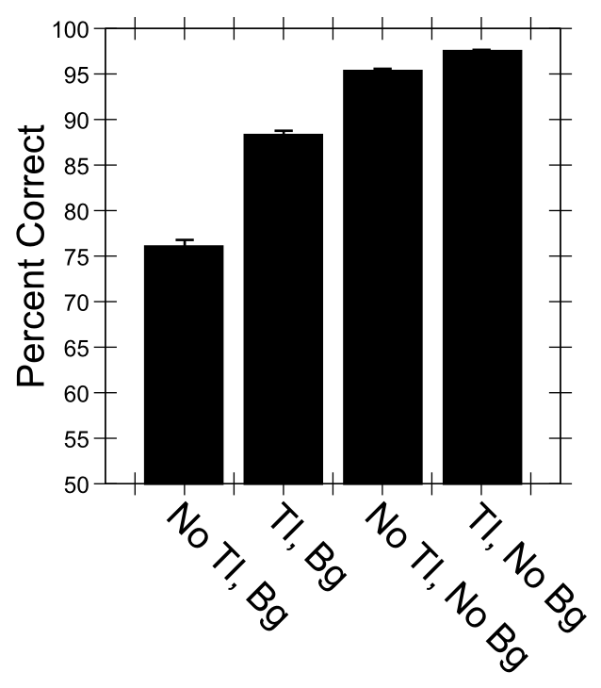
Predictive Auto-Encoding Supports Figure-Ground Segregation
Bg = backgrounds present
No Bg = Not
Differential advantage for backgrounds present case
of TI = Temporal Integration = predictive learning

Slide 29
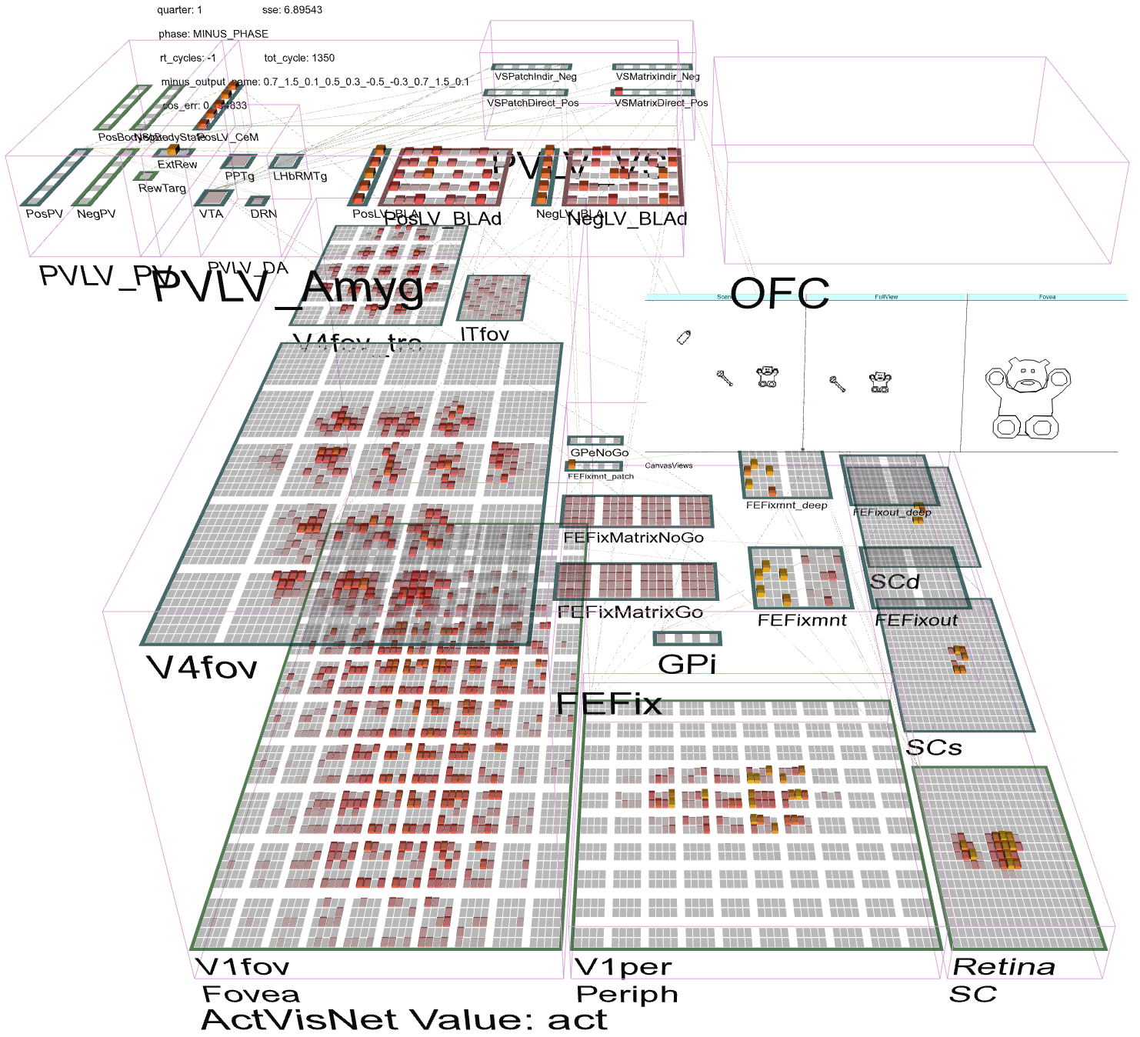
Full Brain Interactions: OFC, FEF..

Slide 30
Conclusions
Recurrent dynamics / consciousness supports goal-driven top-down interaction with bottom-up visual processing:
Bonus: Biological error-driven learning can use recurrent connectivity to communicate gradients
Superficial cortical layers = basic Hopfield / Boltzmann style recurrent network
Deep cortical layers & thalamus = specialized attentional network, key for robust, flexible attn
Also thalamically-driven auto-encoder for each layer

Slide 31
Problems with Recurrent Connectivity
Computationally much slower than feedforward
~100 cycles per input image, 2x+ connections..
Not applicable to ImageNet scale at this point
Could really use fast specialized hardware! (“if I only had a brain…”)
But algorithms are under rapid development..
Much more complex dynamics: learning problem is much more difficult

Slide 32
One Problem or Many?
Image segmentation, scene recognition, object recognition, scene scanning.. typically solved separately in machine vision(?)
Brain appears to use a single integrated bidirectional / attentional network to solve all of these problems together
Object vs. scene is arbitrary – complex objects are “scenes” – need active processing

Slide 33
Thanks To
CCN Lab
Tom Hazy
Seth Herd
Tren Huang
Dave Jilk (eCortex)
Nick Ketz
Trent Kriete
Kai Krueger
Brian Mingus
Jessica Mollick
Wolfgang Pauli
John Rohrlich
Sergio Verduzco-Flores
Dean Wyatte
Maryam Zolfaghar
Funding
ONR – Hawkins
ONR – McKenna & Bello

Slide 34
Extras

Slide 35
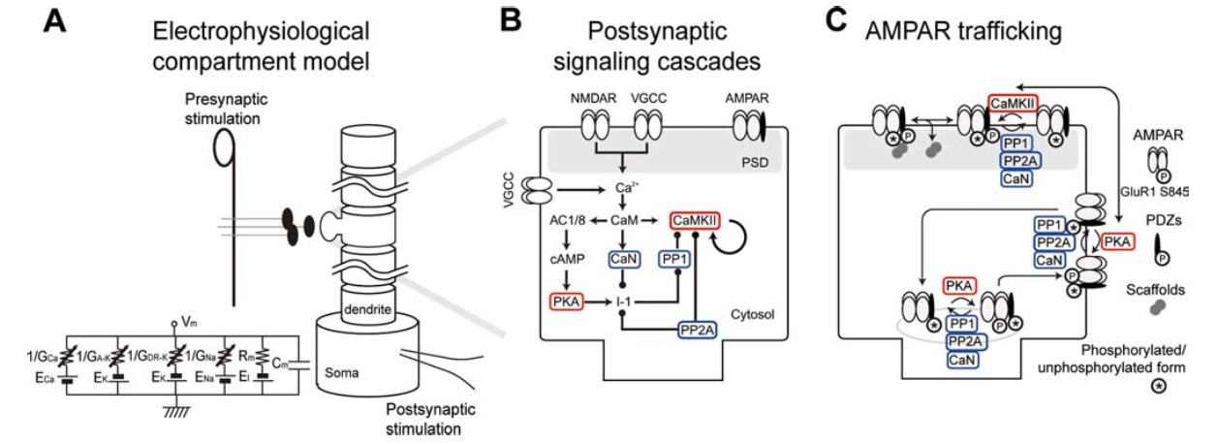
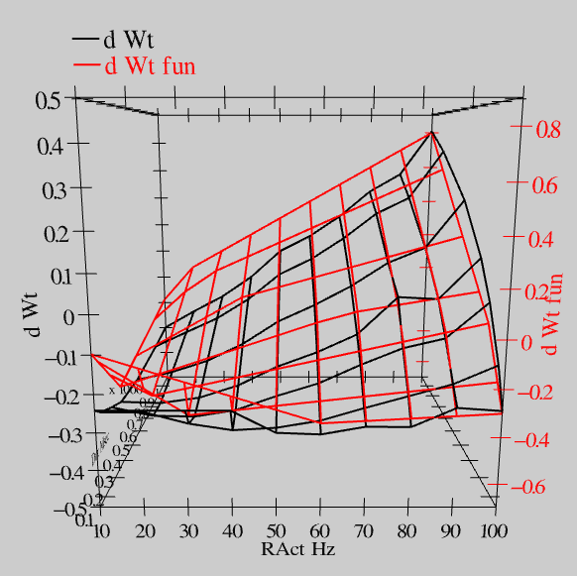
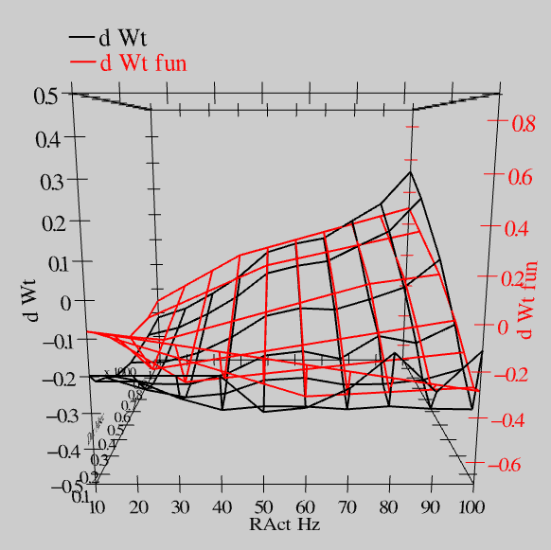
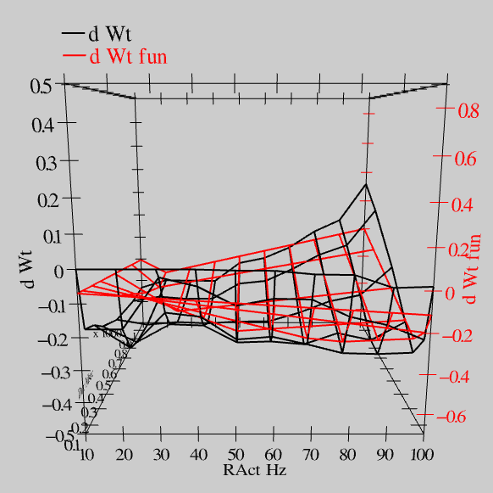
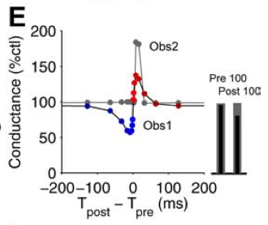
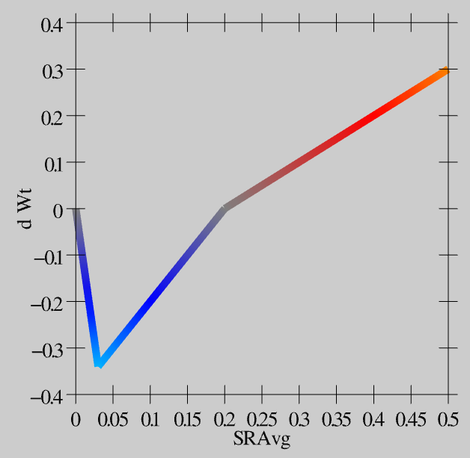
Synaptic Plasticity: XCAL Model (reduction of Urakubo et al, 2008 STDP model)
S = 100Hz
S = 50Hz
S = 20Hz
dW = f(send * recv) =
(spike rate * duration)
r=.894

Slide 36
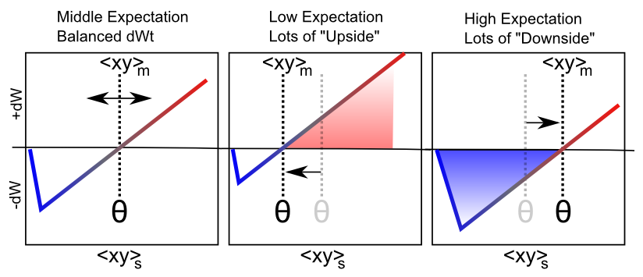
Floating Threshold = Medium Term Synaptic Activity (Error-Driven)
dW = Outcome – Expectation = <xy>_{s} - <xy>_{m}

Slide 37
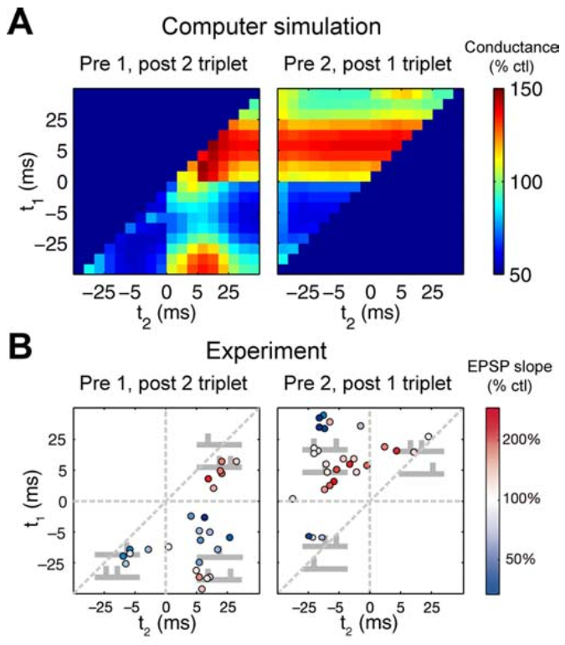
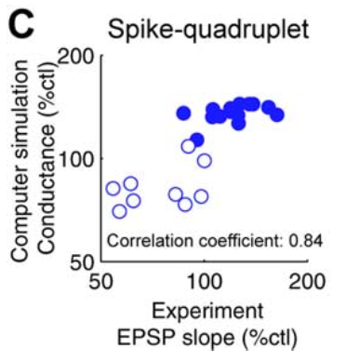
“Allosteric” NMDA Captures STDP (including higher-order and time integration effects)

Slide 38
Differences from HTM
Dendritic spines linearize neuron behavior (Araya, Eisenthal, Yuste, 2006)
Point neurons! They work! (but we do take advantage of differential strength for diff prjns)
Error-driven learning and graded bidirectional constraint satisfaction vs. discrete coincidence detection and discrete activations
More differentiated laminar functionality

Slide 39
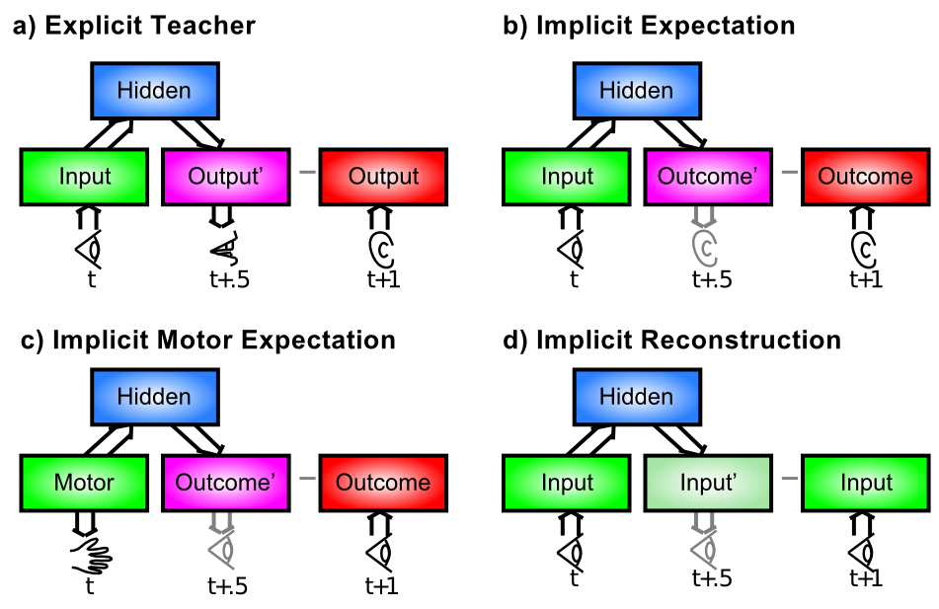
Where do the Targets Come From?

Slide 40
The Bootstrap Solution
How do the high-level “outputs” get active?
From a sensory modality (e.g., auditory input)
Infinite regress: need high-level training of that!
Solution: need to bootstrap our way up to multi-modal mutual-training systems (c.f., Becker, de Sa)
Now we just need a way for sensory modalities to train themselves… and Hebbian learning isn’t up to the task.

Slide 41
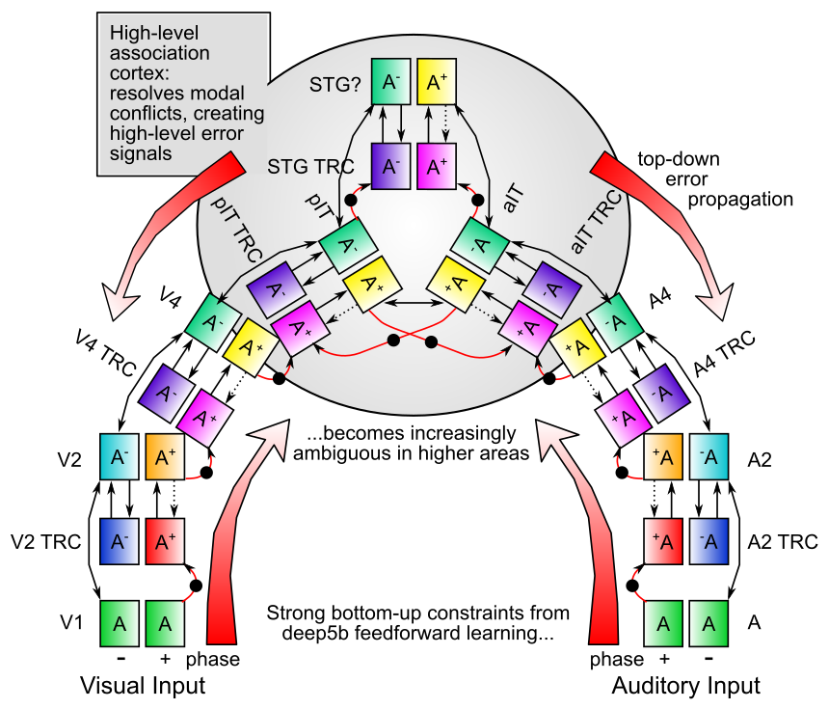

Slide 42
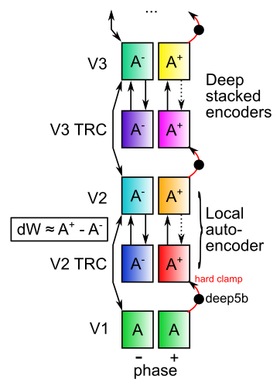
Nested Thalamic Auto-Encoders (Deep5aed: Deep5b Auto Error Driven)
Each layer learns by auto-encoding the layer below (c.f., restricted Boltzmann machines)
Plus phase target: Deep layer 5b neocortical neurons (intrinsic bursting, 10Hz alpha rhythm): drivers of thalamic relay cell (TRC) firing at next feedforward layer (Sherman & Guillery)
Minus phase: weaker but much more numerous layer 6 -> TRC

Slide 43
Nested Thalamic Auto-Encoders (Deep5aed: Deep5b Auto Error Driven)
Advantages:
Automatic, internal – / + phases
deep5b bursting = amplification of error signals – each layer has own local error
Encoding is done on reduced, transformed version of prior layer -> greater abstraction
Full bidirectional constraint satisfaction across network contributes to minus phase
and plus phase: supports both local and distal learning

Slide 44
Nested Thalamic Auto-Encoders (Deep5aed: Deep5b Auto Error Driven)
Advantages:
Each layer is more strongly constrained – should improve generalization and overall robustness – e.g., object recognition operates on “2.5d sketch” of visual world, not just on pixels or gabor jets
Fixes “adversarial image” problem?

Slide 45
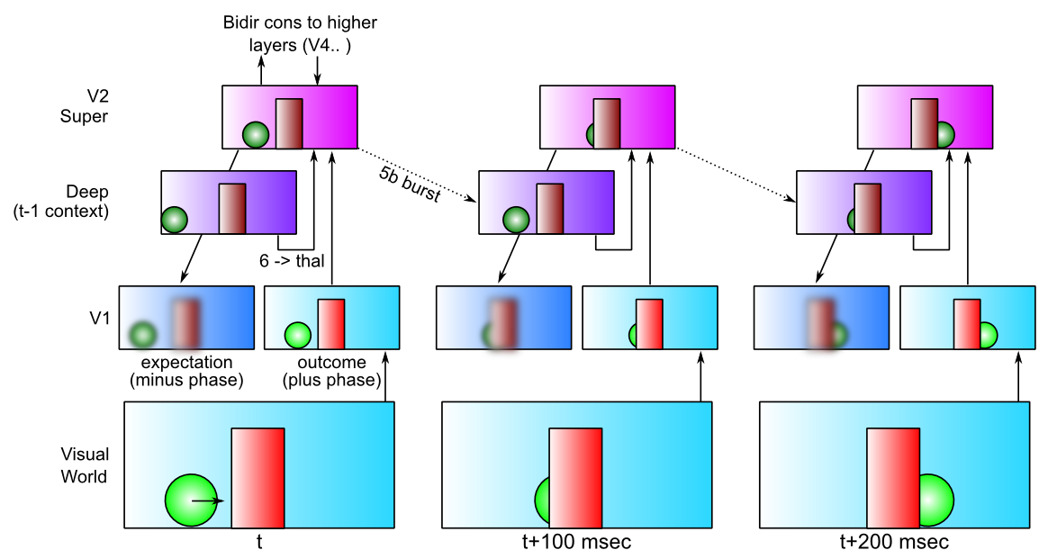
LeabraTI: Learning Through Time

Slide 46
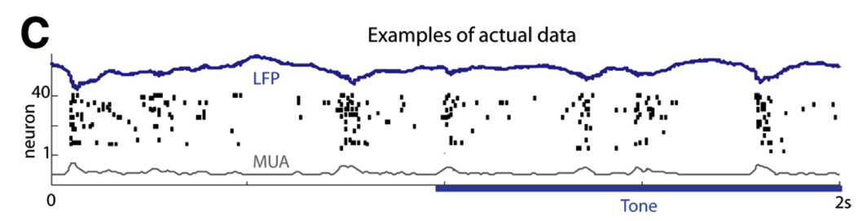
TI: Key Biological Data
Alpha freq dominant in deep layers (e.g., Buffalo et al, 2011).
Sustained auditory tones discretized into alpha “packets” (Luczak et al, 2013)
Many indications of discretization in perception (Van Rullen & Koch, 2003)
Predictive coding during saccades
Deep5b alpha bursting to a continuous auditory tone (Luczak et al, 2013):

Slide 47
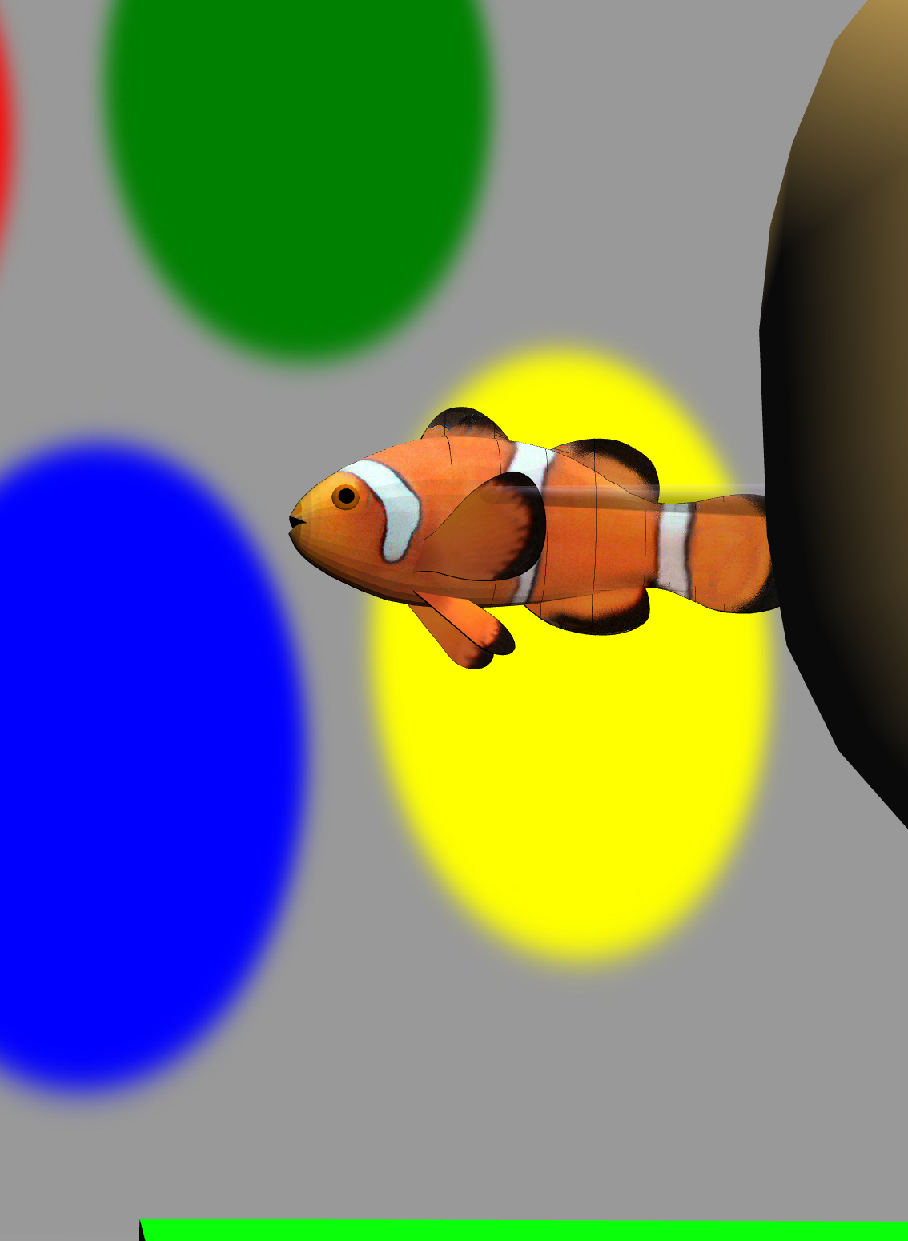
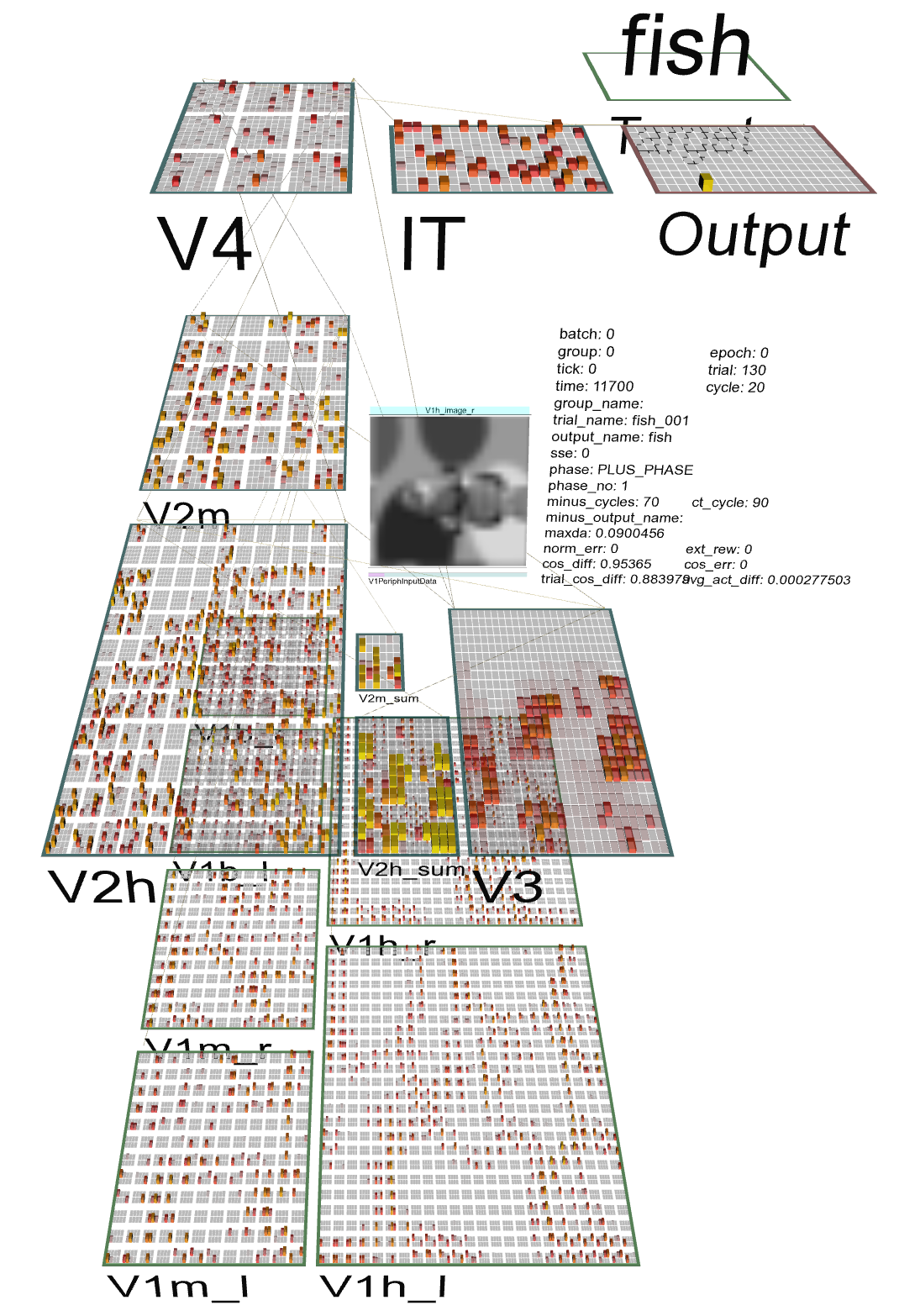
Test Application: Learning Early Visual Structure

